Slide 1
Intro to Machine Learning – week 2
New Github for course materials: https://github.com/fredhutchio/intro-machine-learning

Slide 2
Reading assignment - Discussion
Machine Learning Applications in Cancer Research
Broad exposure to different types of ML models
Applications to susceptibility, recurrence, and survival

Slide 3
Today’s class
Measuring model accuracy
The importance of optimization
Difference in measures between regression and classification methods
The importance of training and testing data sets
Using training and testing errors to drive model selection
Bias/variance trade-off
Exercises

Slide 4
What’s the best ML method?
There is no one-size fits all approach in statistics

Slide 5
What’s the best ML method?
There is no one-size fits all approach in statistics
We need many different approaches depending on the nature of the data
Size of the data - Is the number of observations (n) greater than the number of predictors (p)? Generally, if n > p, we are in good shape with most models as there as sufficient degrees of freedom to estimate the full model (i.e. using all predictors).
Data distributions – Normally distributed or something more exotic?
Available computational power – Not so much of an issue these days.

Slide 6
What’s the best ML method?
Size of data – p >> n
The curse of dimensionality.

Slide 7
What’s the best ML method?
Size of data – p >> n
The curse of dimensionality.
Generally, support vector machines and decision trees work well with a low number of observations.

Slide 8
What’s the best ML method?
Size of data – p >> n
The curse of dimensionality.
Generally, support vector machines and decision trees work well with a low number of observations.
You can also penalize models with more predictors by measuring a models Akaike information criterion (AIC) or Bayesian information criterion (BIC)

Slide 9
What’s the best ML method?
Size of data – p >> n
The curse of dimensionality.
Generally, support vector machines and decision trees work well with a low number of observations.
You can also penalize models with more predictors by measuring a models Akaike information criterion (AIC) or Bayesian information criterion (BIC)
Use subset regression techniques to choose a subset of predictors so that n > p (more later)

Slide 10
What’s the best ML method?
Size of data – p >> n
The curse of dimensionality.
Generally, support vector machines and decision trees work well with a low number of observations.
You can also penalize models with more predictors by measuring a models Akaike information criterion (AIC) or Bayesian information criterion (BIC)
Use subset regression techniques to choose a subset of predictors so that n > p (more later)
n >> p
We have enough degrees of freedom to properly estimate any classic ML approaches (such as linear regression)

Slide 11
What’s the best ML method?
Instead of picking just one machine learning model, we can pick many variations of that model, or many different types of models, and compare the quality of each one.

Slide 12
What’s the best ML method?
Instead of picking just one machine learning model, we can pick many variations of that model, or many different types of models, and compare the quality of each one.
First we need to know how to measure model accuracy, or error rates (e.g. what’s the difference between your estimate and the true outcome among all output variables?)

Slide 13
What’s the best ML method?
Instead of picking just one machine learning model, we can pick many variations of that model, or many different types of models, and compare the quality of each one.
First we need to know how to measure model accuracy, or error rates (e.g. what’s the difference between your estimate and the true outcome among all output variables?)
For regression techniques, we often measure the Mean Squared Error (MSE), while for classification we measure the error-rate or Area Under the Curve (AUC).

Slide 14

Measuring performance
Regression – Mean Square Error

Slide 15
Measuring performance
Regression – Mean Square Error
It is an average of the squared error among all observations. The further away a true observation is from the estimate, it gets penalized at an exponential rate.

Slide 16
Measuring performance
Regression – Mean Square Error
It is an average of the squared error among all observations. The further away a true observation is from the estimate, it gets penalized at an exponential rate.
There are other ways to measure error in a regression setting, such as mean absolute error.

Slide 17
Measuring performance
Classification – Error rate, confusion matrix, and AUC
N = 200 | Predicted: Cancer | Predicted: No cancer
Actual : Cancer | 24 (TP) | 27 (FN)
Actual : No cancer | 13 (FP) | 136 (TN)

Slide 18
Measuring performance
N = 200 | Predicted: Cancer | Predicted: No cancer
Actual : Cancer | 24 (TP) | 27 (FN)
Actual : No cancer | 13 (FP) | 136 (TN)
Accuracy: (TP + TN)/total = 80%

Slide 19
Measuring performance
N = 200 | Predicted: Cancer | Predicted: No cancer
Actual : Cancer | 24 (TP) | 27 (FN)
Actual : No cancer | 13 (FP) | 136 (TN)
Accuracy: (TP + TN)/total = 80%
Sensitivity: TP / (FN + TP) = 47% (ability to correctly detect sick patients)

Slide 20
Measuring performance
N = 200 | Predicted: Cancer | Predicted: No cancer
Actual : Cancer | 24 (TP) | 27 (FN)
Actual : No cancer | 13 (FP) | 136 (TN)
Accuracy: (TP + TN)/total = 80%
Sensitivity: TP / (FN + TP) = 47% (ability to correctly detect sick patients)
Specificity: TN / (TN + FP) = 91% (ability to correctly reject healthy patients)

Slide 21
Measuring performance
N = 200 | Predicted: Cancer | Predicted: No cancer
Actual : Cancer | 24 (TP) | 27 (FN)
Actual : No cancer | 13 (FP) | 136 (TN)
Accuracy: (TP + TN)/total = 80%
Sensitivity: TP / (FN + TP) = 47% (ability to correctly detect sick patients)
Specificity: TN / (TN + FP) = 91% (ability to correctly reject healthy patients)
Even though the full model accuracy is 80%, it performs worse when it matters.

Slide 22
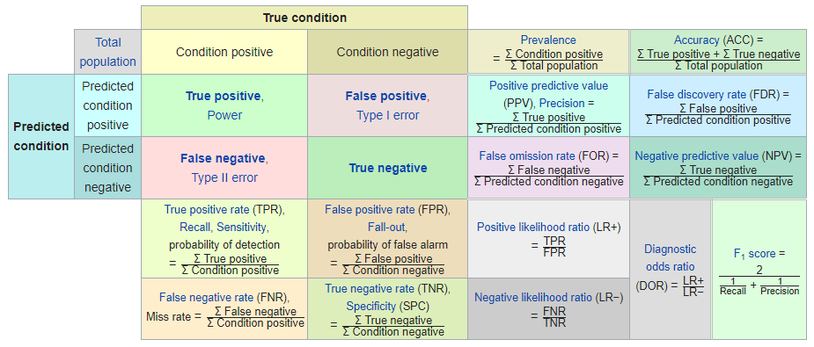
Measuring performance
As you can see, for classification, it’s important to look at different error rates. It gets even crazier!

Slide 23
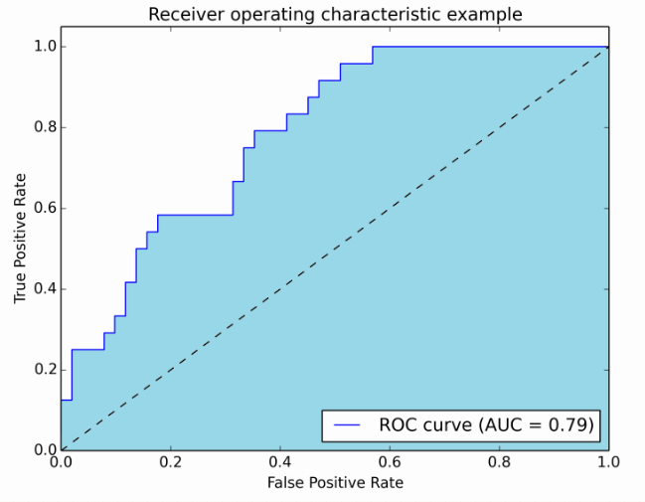
Measuring performance
The AUC, or better explained as the Area Under the Receiver Operating Characteristic Curve, gives us a general look at how well the model performs across sensitivity and specificity.

Slide 24
Measuring performance
The AUC, or better explained as the Area Under the Receiver Operating Characteristic Curve, gives us a general look at how well the model performs across sensitivity and specificity.
An AUC of 1 means the model perfectly classifies the input data

Slide 25
Measuring performance
The AUC, or better explained as the Area Under the Receiver Operating Characteristic Curve, gives us a general look at how well the model performs across sensitivity and specificity.
An AUC of 1 means the model perfectly classifies the input data
The dashed line is how well a random predictor does, receiving an AUC of 0.5
https://stats.stackexchange.com/questions/132777/what-does-auc-stand-for-and-what-is-it

Slide 26
The importance of having training and testing data sets
A ML model is generally fit on a training set to achieve a minimum error, and then later applied to a test data set to get a better idea of out-of-sample error variance.

Slide 27
The importance of having training and testing data sets
A ML model is generally fit on a training set to achieve a minimum error, and then later applied to a test data set to get a better idea of out-of-sample error variance.
Going back to the MSE for regression models, we generally don’t care how well it performs for our training data set (within reason), but how well it performs with the test data set. This will be an estimate of how well out model will perform on future predictions.

Slide 28
The importance of having training and testing data sets
A ML model is generally fit on a training set to achieve a minimum error, and then later applied to a test data set to get a better idea of out-of-sample error variance.
Going back to the MSE for regression models, we generally don’t care how well it performs for our training data set (within reason), but how well it performs with the test data set. This will be an estimate of how well out model will perform on future predictions.
This helps us answer many questions, such as are we over or under fitting the data., and what sort of errors we can expect as new sets of input data come in.

Slide 29
The importance of having training and testing data sets
If the MSE on our testing data set is much higher than what we achieved on our training data set, we are most likely over-fitting the data.

Slide 30
The importance of having training and testing data sets
If the MSE on our testing data set is much higher than what we achieved on our training data set, we are most likely over-fitting the data.
As a model flexibility increases, training MSE will almost always drop, while testing MSE may or may not.

Slide 31
The importance of having training and testing data sets
If the MSE on our testing data set is much higher than what we achieved on our training data set, we are most likely over-fitting the data.
As a model flexibility increases, training MSE will almost always drop, while testing MSE may or may not.
The goal should be to find a model which minimizes the testing data set error.

Slide 32
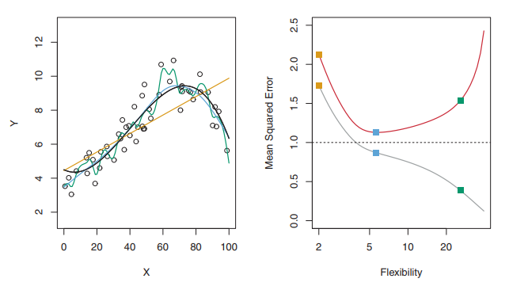
Comparing errors across model flexibility on training and testing data sets
Orange line – Linear regression (inflexible, parametric model)

Slide 33
Comparing errors across model flexibility on training and testing data sets
Orange line – Linear regression (inflexible, parametric model)
Dark blue / light blue / green line – Smoothing splines (flexible to various degrees, non-parametric)

Slide 34
Comparing errors across model flexibility on training and testing data sets
Grey line – training MSE depending on flexibility of model

Slide 35
Comparing errors across model flexibility on training and testing data sets
Grey line – training MSE depending on flexibility of model
Red line – testing MSE

Slide 36
Comparing errors across model flexibility on training and testing data sets
Grey line – training MSE depending on flexibility of model
Red line – testing MSE
Goal is to minimize testing MSE

Slide 37
Comparing errors across model flexibility on training and testing data sets
Grey line – training MSE depending on flexibility of model
Red line – testing MSE
Goal is to minimize testing MSE
As flexibility increases, training MSE decreases as the model over-fits the data

Slide 38
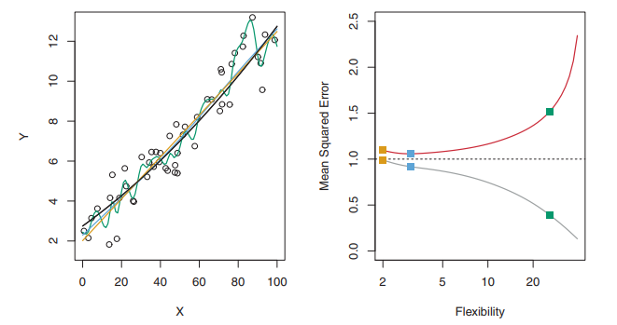
Comparing errors across model flexibility on training and testing data sets

Slide 39
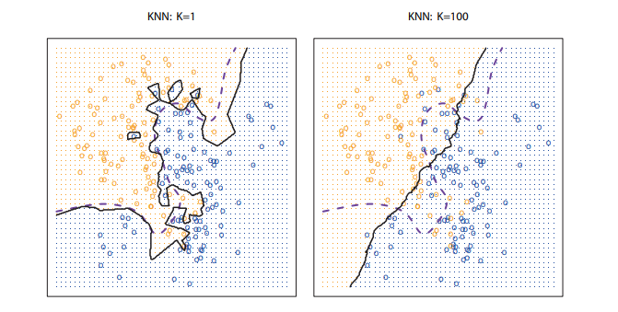
Comparing errors across model flexibility on training and testing data sets
In this classification example, we attempt to properly classify each point (orange or blue) based on the closest k-neighbors

Slide 40
Comparing errors across model flexibility on training and testing data sets
In this classification example, we attempt to properly classify each point (orange or blue) based on the closest k-neighbors
Know as k-nearest neighbor

Slide 41
Comparing errors across model flexibility on training and testing data sets
In this classification example, we attempt to properly classify each point (orange or blue) based on the closest k-neighbors
Know as k-nearest neighbor
The higher k is, the lower model flexibility is and begins to approach a more linear form

Slide 42
Comparing errors across model flexibility on training and testing data sets
In this classification example, we attempt to properly classify each point (orange or blue) based on the closest k-neighbors
Know as k-nearest neighbor
The higher k is, the lower model flexibility is and begins to approach a more linear form
If k = 1, this is the most flexible version of the model, and any prediction will simply be the class of whichever point is closest

Slide 43
Comparing errors across model flexibility on training and testing data sets
In this classification example, we attempt to properly classify each point (orange or blue) based on the closest k-neighbors
Know as k-nearest neighbor
The higher k is, the lower model flexibility is and begins to approach a more linear form
If k = 1, this is the most flexible version of the model, and any prediction will simply be the class of whichever point is closest
This creates a decision boundary for our classifier.

Slide 44
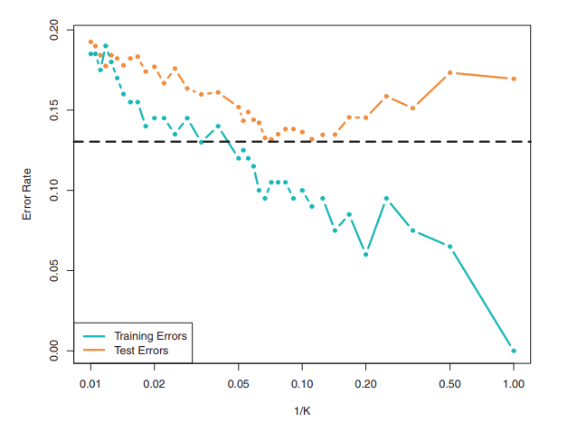
Comparing errors across model flexibility on training and testing data sets
Classification example, using error rate instead of MSE

Slide 45
Comparing errors across model flexibility on training and testing data sets
Classification example, using error rate instead of MSE
Uses k-nearest neighbors algorithm

Slide 46
Comparing errors across model flexibility on training and testing data sets
Classification example, using error rate instead of MSE
Uses k-nearest neighbors algorithm
Can see similar behavior as in the regression setting

Slide 47
Comparing errors across model flexibility on training and testing data sets
Classification example, using error rate instead of MSE
Uses k-nearest neighbors algorithm
Can see similar behavior as in the regression setting
As flexibility increases, we over-fit the training data, and training error rate decreases, while testing error rate follows the U-shape curve

Slide 48
Bias-Variance trade-off
So, why does the test error tend to follow a U-shaped curve?
It’s the result of two competing properties: bias and variance

Slide 49
Bias-Variance trade-off
So, why does the test error tend to follow a U-shaped curve?
It’s the result of two competing properties: bias and variance
Variance is the amount our estimation will change if we use a different training data set
More flexible models tend to have more variance. Very flexible models have a habit of overfitting the data, creating higher errors if we re-select our training samples.

Slide 50
Bias-Variance trade-off
So, why does the test error tend to follow a U-shaped curve?
It’s the result of two competing properties: bias and variance
Variance is the amount our estimation will change if we use a different training data set
More flexible models tend to have more variance. Very flexible models have a habit of overfitting the data, creating higher errors if we re-select our training samples.
Bias are the errors that result from trying to fit a complex real-life relationship with simple models.
More flexibility leads to lower bias and higher variance in our model

Slide 51
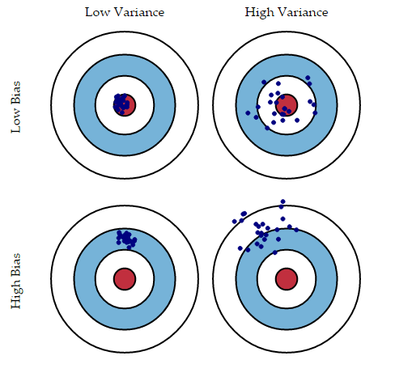
Bias-Variance trade-off

Slide 52

Bias-Variance trade-off
The testing MSE curve is a measure of both the bias and variance of the model
Scary equation:
It’s easy to find a model with high variance and low bias (drawing a curve that passes through every point)
It’s also easy to find a model with low variance and high bias (horizontal line; our function f(X) does not change much with new data)

Slide 53
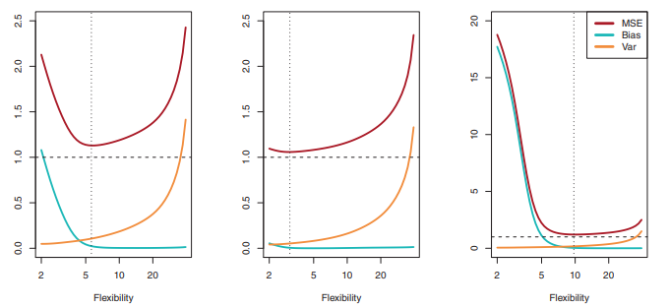
Bias-Variance trade-off

Slide 54
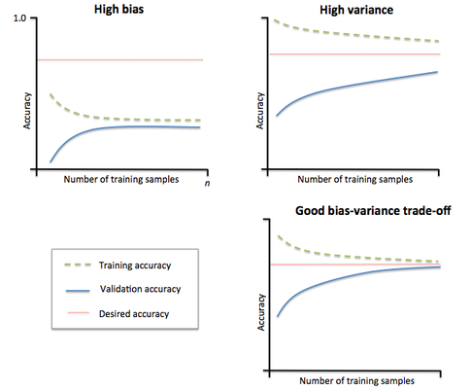
Bias-Variance trade-off: Learning Curves
Start with one single instance of data

Slide 55
Bias-Variance trade-off: Learning Curves
Start with one single instance of data
Slowly increase number of samples and retrain the model

Slide 56
Bias-Variance trade-off: Learning Curves
Start with one single instance of data
Slowly increase number of samples and retrain the model
Training and testing (validation) accuracy should come together as more samples are added.

Slide 57
Bias-Variance trade-off: Learning Curves
Start with one single instance of data
Slowly increase number of samples and retrain the model
Training and testing (validation) accuracy should come together as more samples are added.
This is another way to diagnose the bias and variance of a specific ML model

Slide 58
Exercises
For each of parts (a) through (d), indicate whether we would generally expect the performance of a flexible statistical learning method to be better or worse than an inflexible method. Justify your answer.
The sample size n is extremely large, and the number of predictors p is small.
The number of predictors p is extremely large, and the number of observations n is small.
The relationship between the predictors and response is highly non-linear.
The variance of the error terms is extremely high.

Slide 59
Exercises
Explain whether each scenario is a classification or regression problem, and indicate whether we are most interested in inference or prediction. Finally, provide n and p.
We collect a set of data on the top 500 firms in the US. For each firm we record profit, number of employees, industry and the CEO salary. We are interested in understanding which factors affect CEO salary.
We are considering launching a new product and wish to know whether it will be a success or a failure. We collect data on 20 similar products that were previously launched. For each product we have recorded whether it was a success or failure, price charged for the product, marketing budget, competition price, and ten other variables.

